Slide 1
Welcome to Curriculum Night
3rd Grade
September 25, 2014

Slide 2
Arrival
Turn in notes and/or money
Complete Morning Work/Check-in
Book shop
Complete unfinished work
Put on nametags

Slide 3
P.A.T. / Lunch
Playground, Field, Blacktop, Hawks Nest
Lunch
Sign in at the office
Birthday Treats
Dine with your child & 1 friend from any 3rd grade class

Slide 4
Snack Time
DiVito/Hanson – snack is supplied
Only water to drink
Dry, healthy snacks (please no fruit cups, applesauce, etc.)

Slide 5
Block Schedule
Classrooms are partnered
Literacy/Math and Content
Best needs for the students…I/E

Slide 6
Parent Communication
Teacher Email
Email Blast
Grade level newsletter (monthly)
Conferences-October

Slide 7
Conferences
1st Quarter conferences are required
Personalized Education Plans
RtI plans (Response to Intervention)
Power School
Check grades online using Parent Portal
Login information was sent home with progress reports

Slide 8
Assessments
BOG
MAP
TRC
DIBELS
DAZE
EOG

Slide 9
Read to Achieve
HB 950
More info. at a later time

Slide 10
We also use a 4,3,2,1 scale: 4=100 2 = 74 3.5=94 1.5 = 70 3 = 87 1 = 61 2.5 = 81
Grades
In Second Grade….
Percentage | Grade
100% - 85% (A, B) | 3
84% - 70% (C, D) | 2
<70% F | 1
CMS Grading Scale: 3rd – 12th
Percentage | Grade
100% - 93% | A
92% - 85% | B
84% - 77% | C
76% - 70% | D
<70% | F
Retesting:
If students score less than an 84% on a unit test, there will be a retest one week later.

Slide 11
Dismissal
Agendas
Mailboxes
Changes in Transportation-sent in the morning in writing

Slide 12
Social Studies
Social Studies Units
History: Historical Figures and Local Communities
Geography and Environmental Literacy
Economics and Financial Literacy
Civics and Governance
Culture: Diverse Cultures in Local Communities
Notes:
12

Slide 13
Science
Science Units
Matter
Energy
Earth, Moon and Sun
Earth Systems
Ecosystems
Skeletal and Muscular System
Force and Motion

Slide 15
Investigations Units
Numbers and Operations (+, -, x, ÷)
Geometry
Algebraic Thinking
Fractions
Measurement and Data

Slide 16
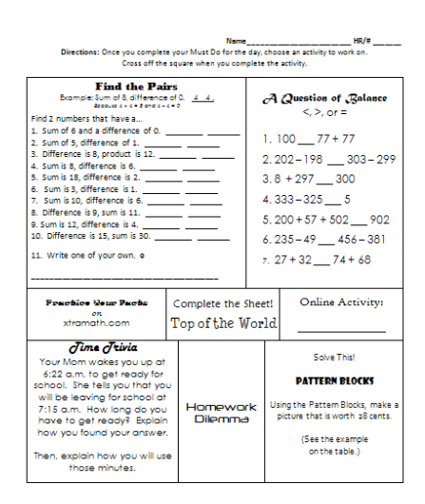

Slide 17
https://email.cms.k12.nc.us/owa/redir.aspx?C=g9Vm1xykx0SRzk36xkdz4P_SBSZRrNFIzbSg44gUC9nFKV91qkJz9r1aZO7XIlJGt6qqlo0iyURL=https%3a%2f%2fwww.youtube.com%2fwatch%3fv%3dg0nuomCCu9A
k4.&

Slide 18
Readers’ Workshop
Readers’ Tools
Reading Logs
Reader’s Notebooks
Book Boxes
Just Right Books
Structure
Mini-Lesson
Independent Reading
Conferences
Guided Group / Book Clubs
Partner Reading

Slide 19
Word Study
Phonics activities
Word Study (ex. Words Their Way (Bear at al.), Month by Month Phonics (Cunningham & Hall))
Vocabulary Work
Spelling Inventory groups students based on their needs.

Slide 20
Writers’ Workshop
Structure
Mini-Lesson
Conferences
Independent Writing
Writers’ Notebooks
Cursive Handwriting (during Intervention and Extension time)

Slide 21
Thank you for coming!
Questions?

